Slide 1
Electric fields
Success Criteria
I can draw electric field diagrams and explain the properties shown in the diagrams.
I can calculate the force on a free charge in an electric field.

Slide 2
Electric Fields
Prior Knowledge
+
-
+
+
-
-
Notes:
Example of positively charged object: proton, alpha particle, positively charged ion (Na⁺)
Example of negatively charged object: electron, negatively charged ion (Cl⁻)
What would happen if +ve and -ve close to each other? Attract
+ve and +ve? Repel
-ve and -ve? Repel
But why?

Slide 3
Electric Fields
Prior Knowledge
Fields are used to visually display non-contact forces:
Gravitational fields
Electric fields
Magnetic fields
Just like how all objects with mass produce a gravitational field (exert a force due to gravity on other objects with mass), all objects with charge exert an electric field.
+
-
Notes:
Example of positively charged object: proton, alpha particle, positively charged ion (Na⁺)
Example of negatively charged object: electron, negatively charged ion (Cl⁻)
What would happen if +ve and -ve close to each other? Attract
+ve and +ve? Repel
-ve and -ve? Repel

Slide 4
Electric Fields
Prior Knowledge
Draw the gravitational fields of each object
Individually
Combined
Remember:
Arrows show the direction of the force
Density of lines indicate strength of force
Earth
Moon
Notes:
Draw the gravitational fields of each object individually

Slide 5
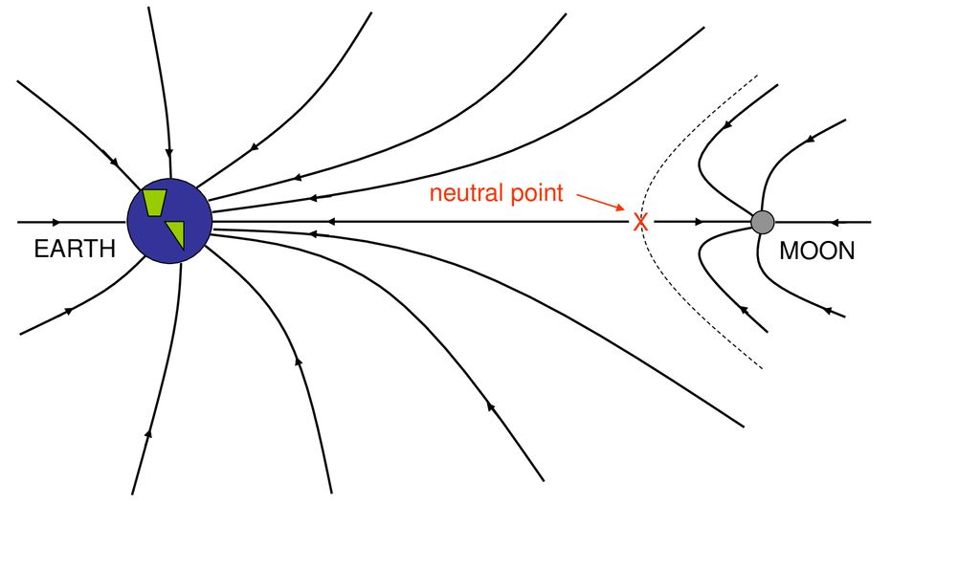
Electric Fields
Prior Knowledge
Remember:
Arrows show the direction of the force
Density of lines indicate strength of force

Slide 6
Electric Fields
Content Development
Electric fields show the forces exerted on a positively charged object.
The arrows point away from a positive source and towards a negative source.
+
-

Slide 7
Electric Fields
Content Development
Electric fields show the forces exerted on a positively charged object.
The arrows point away from a positive source and towards a negative source.
-
+
+
+
-

Slide 8
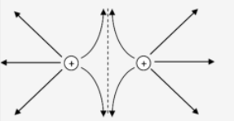
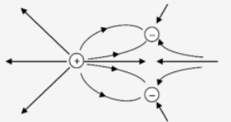
Electric Fields
Content Development
Electric fields show the forces exerted on a positively charged object.
The arrows point away from a positive source and towards a negative source.
-
+
+
+
-

Slide 9
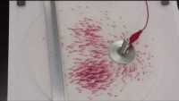
Electric Fields
Content Development
Notes:
https://www.youtube.com/watch?v=63FnT0W-Hxc&ab_channel=JamesLincoln
In this video crystals of potassium permanganate dissolve and flow toward the positive electrode. This is because the manganate ion is negative.

Slide 10

Electric Fields
Content Development
The lines in an electric field display the forces – the force that will be exerted on a positively charged object. A negatively charged object will experience a force in the opposite direction of the lines.
Electric field strength
The amount of force that the field applies to a unit of charge
E = electric field strength (NC⁻¹)
F = force acting on the charge (N)
q = quantity of the charge (C)
+
+

Slide 11

Electric Fields
Content Development
The lines in an electric field display the forces – the force that will be exerted on a positively charged object. A negatively charged object will experience a force in the opposite direction of the lines.
Electric field strength
The amount of force that the field applies to a unit of charge
E = electric field strength (NC⁻¹)
F = force acting on the charge (N)
q = quantity of the charge (C)
Gravitational field strength
The amount of force that the field applies to a unit of mass
g = gravitational field strength (Nkg⁻¹)
F_{g} = force acting on the object (N)
m = mass of the object (kg)
Notes:
Note:
The charge is of the object being studied, not the object creating the field.
Similar to gravitational field strength where we look at the mass of the person, not the mass of the Earth

Slide 12

Electric Fields: Coulomb’s Law
Content Development
The force between two point charges can be calculated using Coulomb’s Law.
The amount of force that one point charge applies to another
F = force (N)
ε₀ = electric permittivity of a vacuum (8.85 x 10⁻¹² Fm⁻¹) (“epsilon-nought”)
q₁ and q₂ = the electric charges (C)
r = the separation (m)
+
+
Notes:
ε = electric permittivity: how well electric fields will pass through a medium
Point charges:
Something so small that the charge isn’t distributed. The charge occurs at one single point in space (like an electron)
https://www.wtamu.edu/~cbaird/sq/2014/02/07/what-is-the-shape-of-an-electron/

Slide 13

Electric Fields: Coulomb’s Law
Content Development
The force between two point charges can be calculated using Coulomb’s Law.
The amount of force that one point charge applies to another
F = force (N)
ε₀ = electric permittivity of a vacuum (8.85 x 10⁻¹² Fm⁻¹) (“epsilon-nought”)
q₁ and q₂ = the electric charges (C)
r = the separation (m)

Slide 14
Electric Fields: Coulomb’s Law
Content Development
What force is applied to a 1.00 mC point charge located 2.00 cm from a 20.0 mC point charge?
Calculate the electric field strength 2.00 cm from each of the charges, absent the other charge (i.e., assume only one charge is present at a time).
Notes:
F = 4.49X10^8 N (remember to convert mC to C)
E1 (strength of big charge) = force at charge 2 / charge 2 = 4.49*10^8 / 1*10^-3 = 4.49 X 10^11 NC⁻¹
(remember: field strength is force per unit charge. You already have the force, so need to divide by the charge. Charge of the other object, not the central object).
E2 (strength of the small charge) = 4.49*10^8 / 20*10^-3 = 2.25*10^10 NC⁻¹
(remember: equal and opposite forces)

Slide 15
Electric Fields: Coulomb’s Law
Content Development
A sodium ion has a +1 relative atomic charge which indicates it has one more proton than electron. This ion is placed in a 4.00 NC⁻¹ electric field.
Calculate the force applied to a single sodium ion in this electric field
A different ion is placed in the electric field. It moves in the opposite direction to the sodium ion and experiences a 1.28 * 10⁻¹⁸ N force. Calculate the relative atomic charge of the ion.

Slide 16
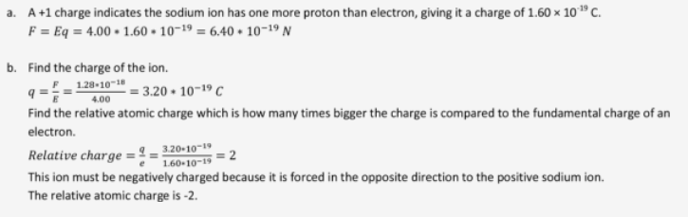
Electric Fields: Coulomb’s Law
Content Development
A sodium ion has a +1 relative atomic charge which indicates it has one more proton than electron. This ion is placed in a 4.00 NC⁻¹ electric field.
Calculate the force applied to a single sodium ion in this electric field
A different ion is placed in the electric field. It moves in the opposite direction to the sodium ion and experiences a 1.28 * 10⁻¹⁸ N force. Calculate the relative atomic charge of the ion.

Slide 17
Electric Fields: Coulomb’s Law
Content Development
Calculate the electric field intensity in the region of space 20.0 cm away from a 125 mC point charge.
Note: intensity = strength

Slide 18
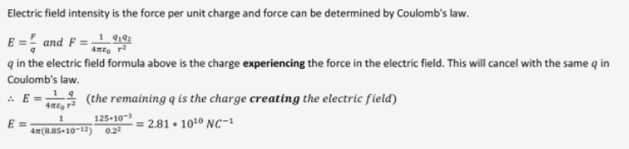
Electric Fields: Coulomb’s Law
Content Development
Calculate the electric field intensity in the region of space 20.0 cm away from a 125 mC point charge.
Note: intensity = strength

Slide 19
Electric Fields: Uniform Electric Field
Content Development
The electric field between two charged parallel plates:
+ + + + + + + + + + +
E = electric field strength (Vm⁻¹)
V = potential difference between the plates (V)
r = the separation of the plates (m)
- - - - - - - - - - -
Notes:
Remember that the field at the edges of the plates has a curve.
Draw the field from +ve to –ve. It is the force that a positive charge experiences therefore away from the positive plate and towards the negative plate.

Slide 20
Electric Fields: Uniform Electric Field
Content Development
The electric field between two charged parallel plates:
+ + + + + + + + + + +
E = electric field strength (Vm⁻¹)
V = potential difference between the plates (V)
r = the separation of the plates (m)
- - - - - - - - - - -
Remember the curves lines on the edge of the plates!
Notes:
Remember that the field at the edges of the plates has a curve.
Draw the field from +ve to –ve. It is the force that a positive charge experiences therefore away from the positive plate and towards the negative plate.

Slide 21
Electric Fields: Coulomb’s Law
Content Development
Calculate the electric field strength between two long parallel plates separated by 10.0 cm when a 120 V potential difference is applied to the plates.
Notes:
E = V/d = 120/0.1 = 120*10^3 N/C

Slide 22
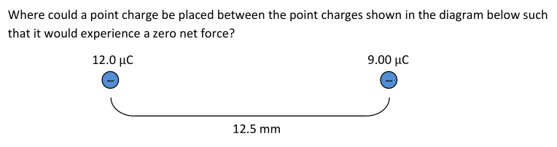
Electric Fields: Coulomb’s Law
Content Development

Slide 23
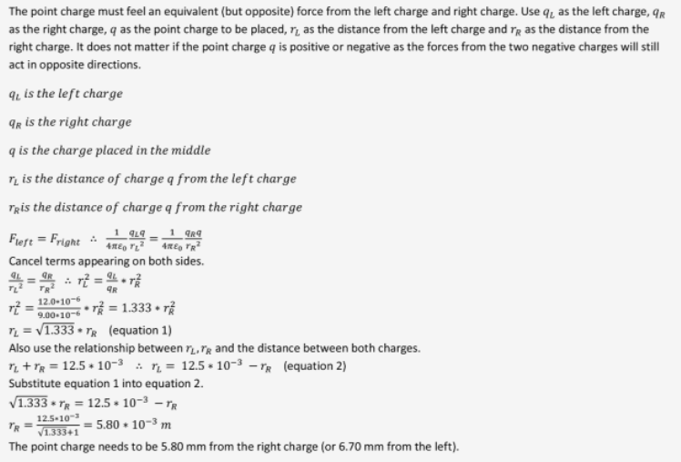
Electric Fields: Coulomb’s Law
Content Development

Slide 24
Electric fields
Success Criteria
I can draw electric field diagrams and explain the properties shown in the diagrams.
I can calculate the force on a free charge in an electric field.

Slide 25
Electric Fields
Content Development

Slide 26
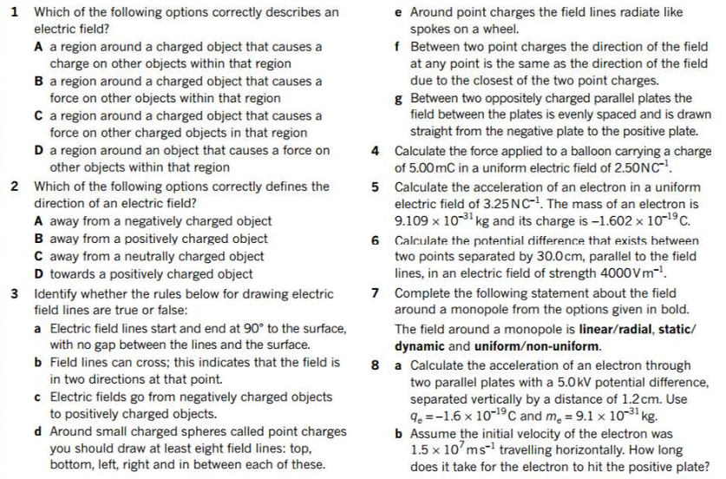

Electric Fields
Additional Study
Notes:
C
B
T, F (no crossing!), F (away from positively charged objects), T (though not super important I think – you might want to draw fewer lines to indicate a difference in field strengths between two charges), T, F (need to consider how the fields interact. How would a positive charge move if it appeared in that location?), False (draw from the positive to the negative and include the curved sides)
1.25 x 10^-2 N
5.72 x 10^-11 ms^-2
1200 V
Radial, static, non-uniform. ‘Uniformity’ is a bit confusing here. The lines are straight, equally spaced, and radiating from the centre. Any equidistant location has the same field strength, but the field strength decreases with radius (note that the density of lines decreases as you move away from the charged object).
a) 3 x 10^16 ms^-2 in the opposite direction to the field b) 4.0 x 10^-10 s

